Slide 1
Simulation and Evaluation of a Drone‑Related Vibration Control Mechanism
Course: Drone Technologies and its Transformative Applications
Students Name: Kanish Koushik - 2362867 Mukhunthan - 2362870 Sidharth Sivan - 2362869 Ganesh Reddy - 2362868
Batch Number: 21
Institution: Christ (Deemed to be University)
Date: 10-03-2026

Slide 2
Aim
Design, simulate, and evaluate a vibration control mechanism for drone systems.
Improve drone stability using vibration damping methods.
Analyze performance through simulation.

Slide 3
Introduction
Drones are used in aerial photography, surveillance, agriculture monitoring, and delivery systems.
During flight, vibrations occur due to motors, propellers, and environmental disturbances.
These vibrations affect flight stability, sensors, and camera quality.

Slide 4
Problem Statement
Drone mechanical systems experience continuous vibrations.
Uncontrolled vibrations lead to instability and inaccurate sensor readings.
A vibration damping system must be designed and analyzed.

Slide 5
Vibration Control Mechanisms
Rubber Dampers – absorb vibrations using flexible mounts.
Spring‑Damper System – reduces oscillations using springs and dampers.
Viscoelastic Materials – dissipate vibration energy.

Slide 6
Mathematical Model
The vibration system is modeled as a Mass‑Spring‑Damper system.
Equation of motion:
m x'' + c x' + k x = F(t)
m = mass, c = damping coefficient, k = stiffness, x = displacement.

Slide 7
Simulation Method
Simulation tools: MATLAB / Simulink or Python.
Steps:
1. Create vibration model
2. Apply external vibration forces
3. Implement damping mechanisms
4. Measure displacement and vibration reduction

Slide 8
Simulation Results
Without damping – high oscillations occur.
With damping – oscillations reduce quickly.
Optimal damping improves drone stability.

Slide 9
Comparison of Damping Methods
Rubber Dampers – medium efficiency, low cost.
Spring‑Damper System – high efficiency, effective vibration reduction.
Viscoelastic Materials – high efficiency but higher cost.

Slide 10
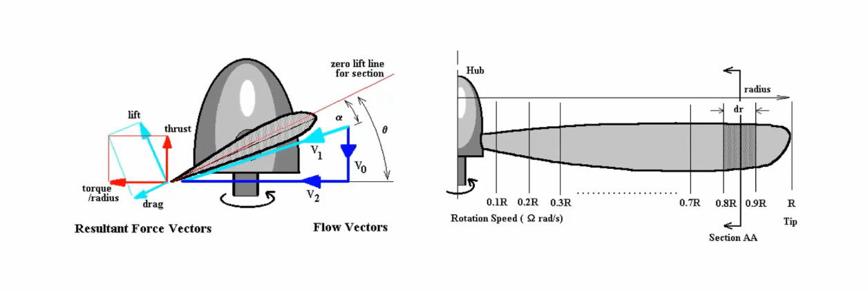

Slide 11
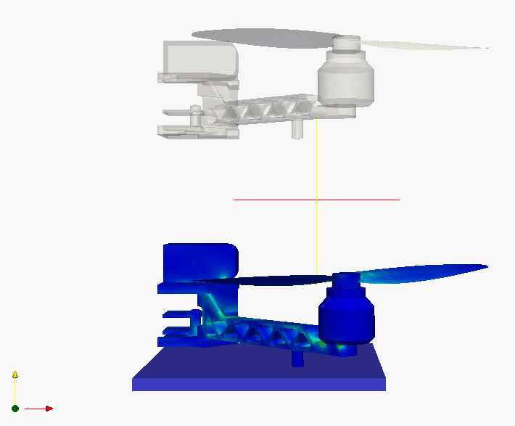

Slide 12
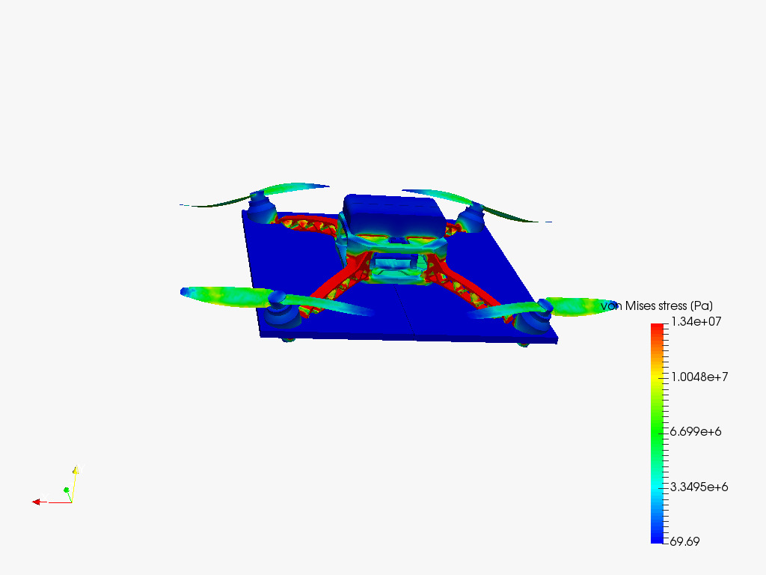

Slide 13
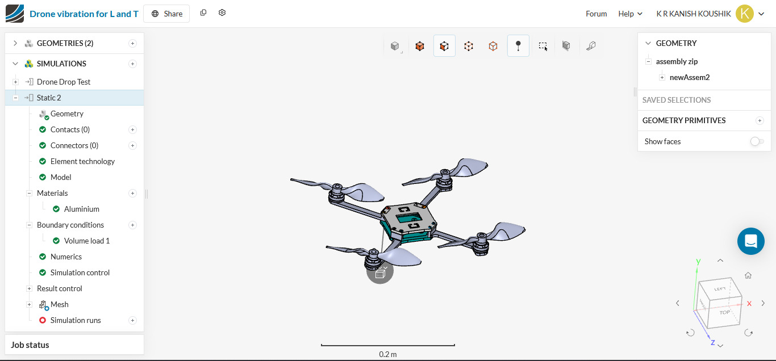

Slide 14
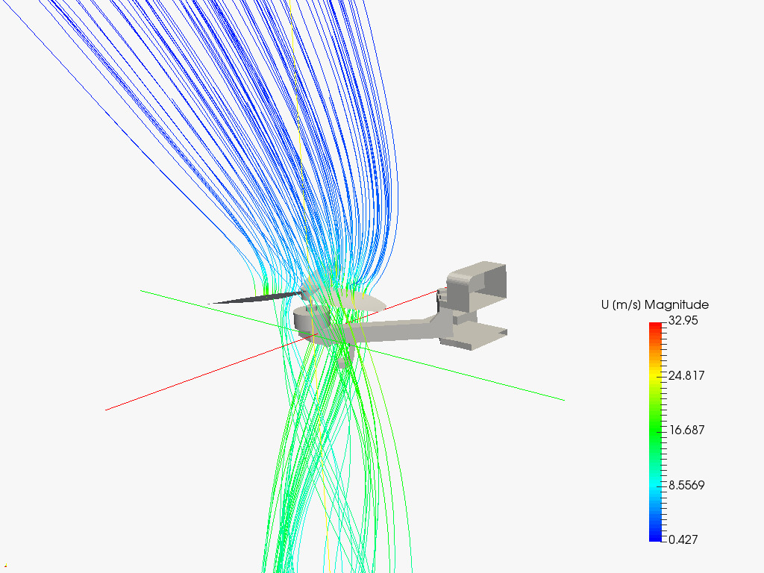

Slide 15
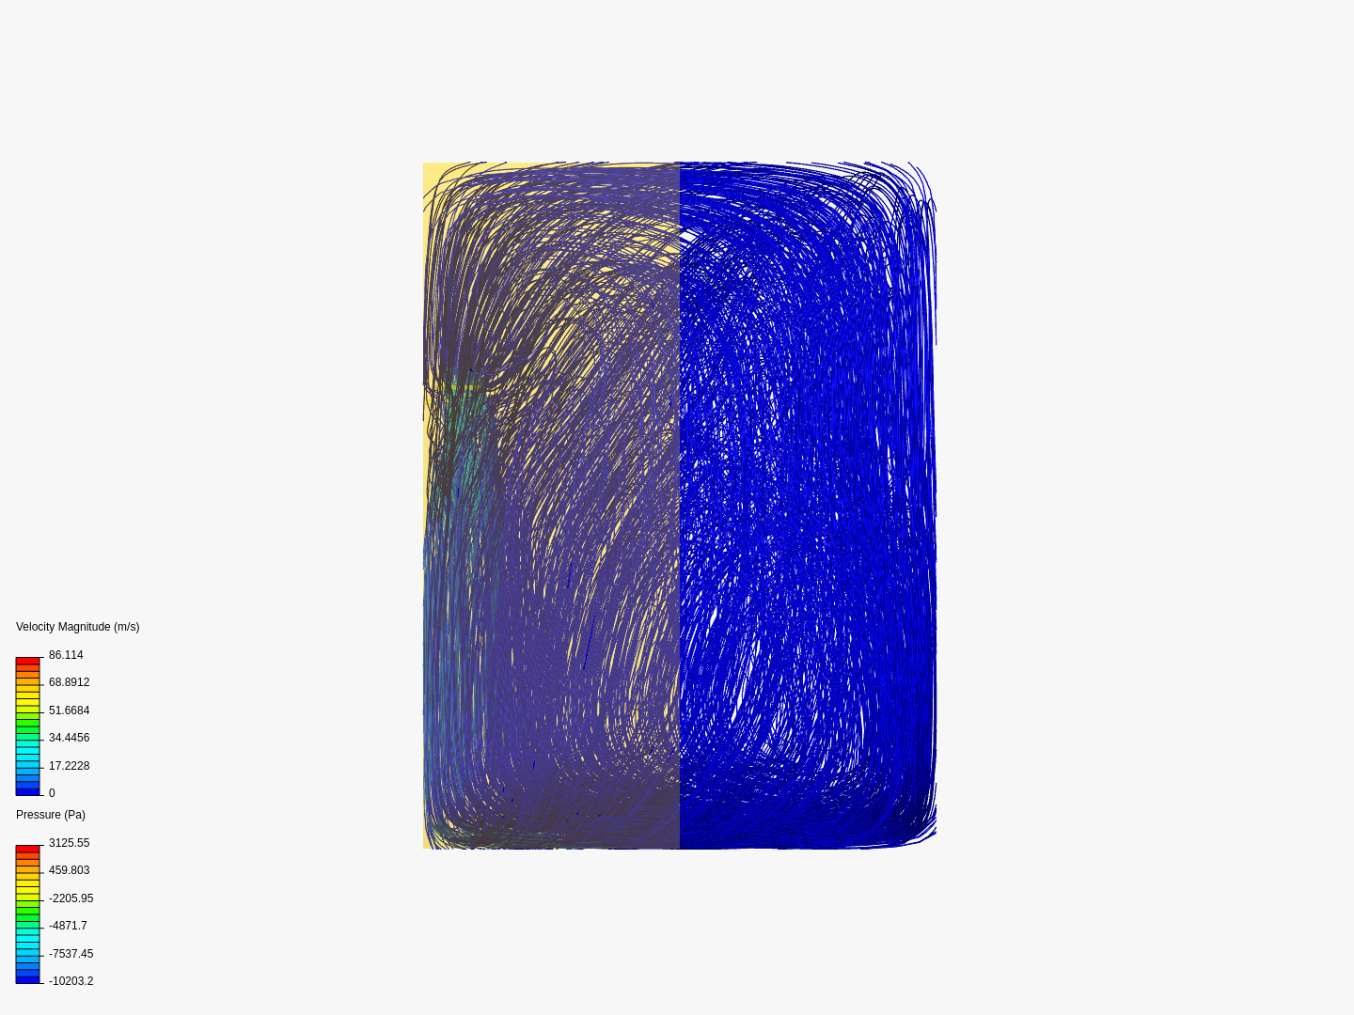

Slide 16
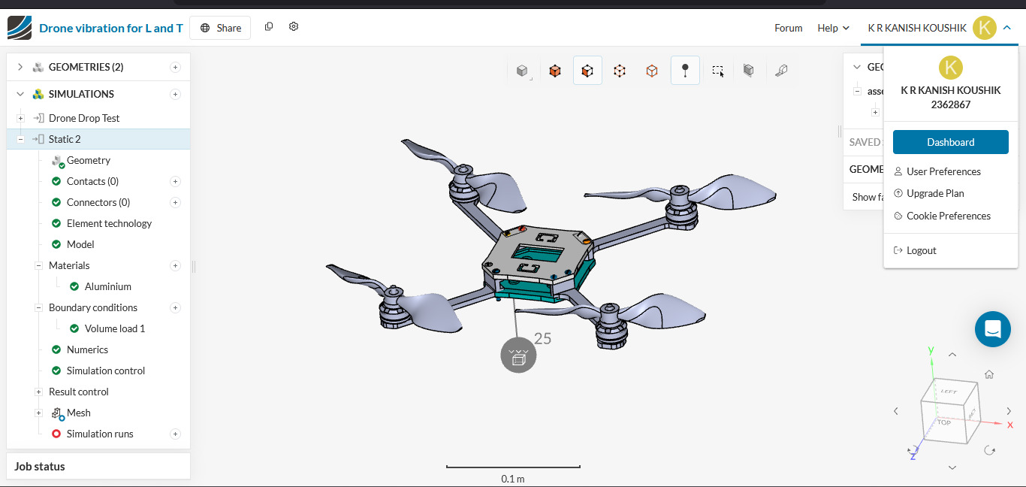

Slide 17
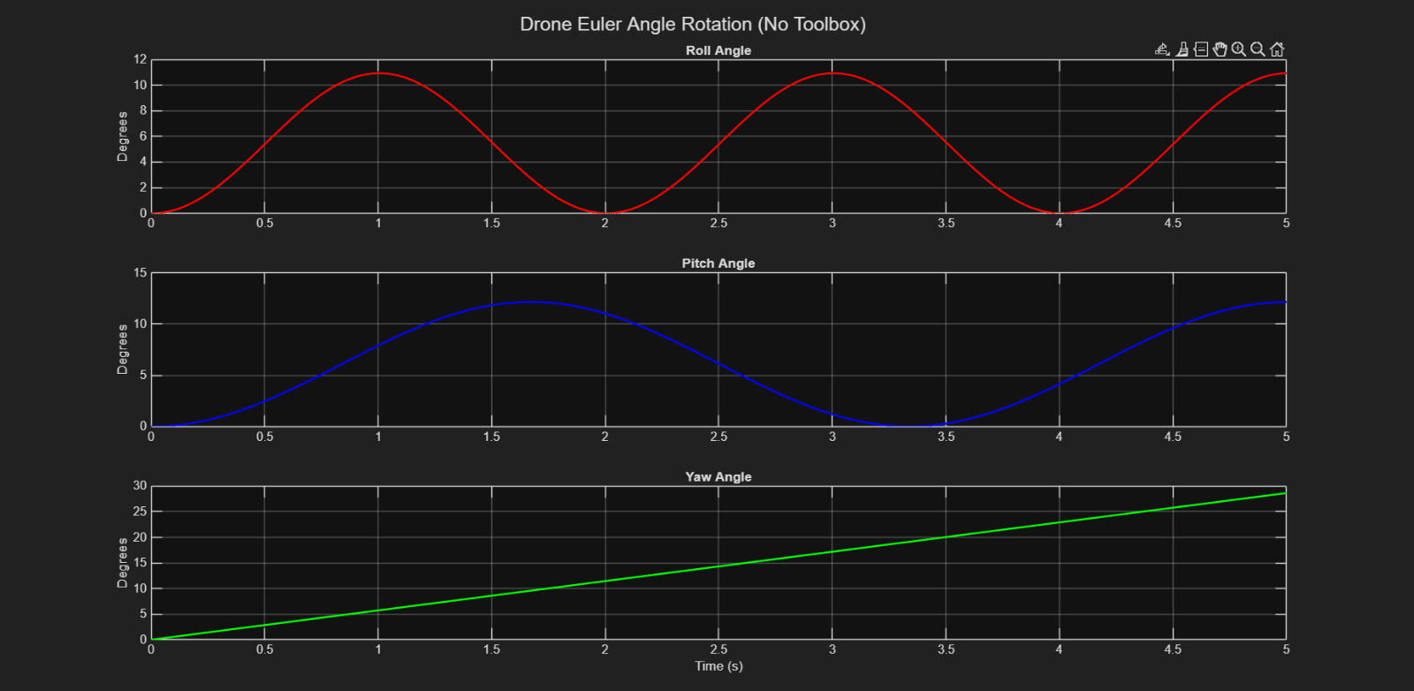

Slide 18
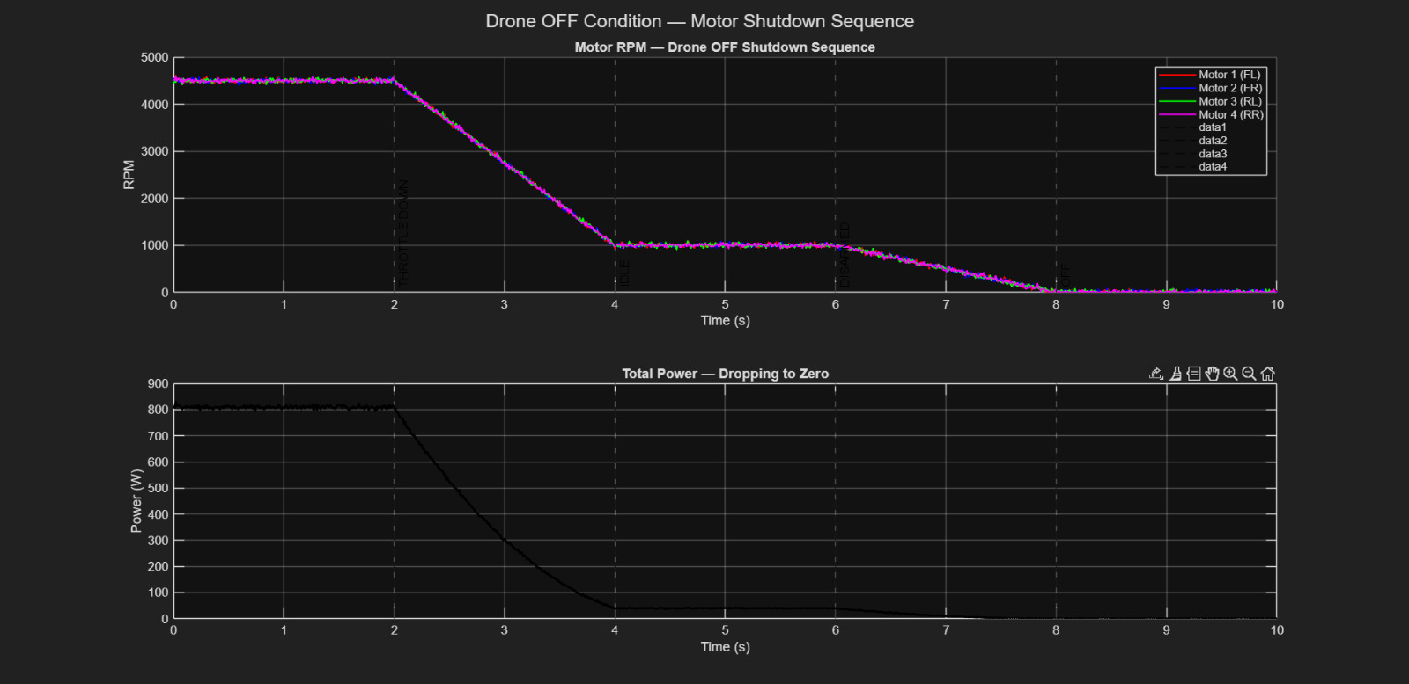

Slide 19
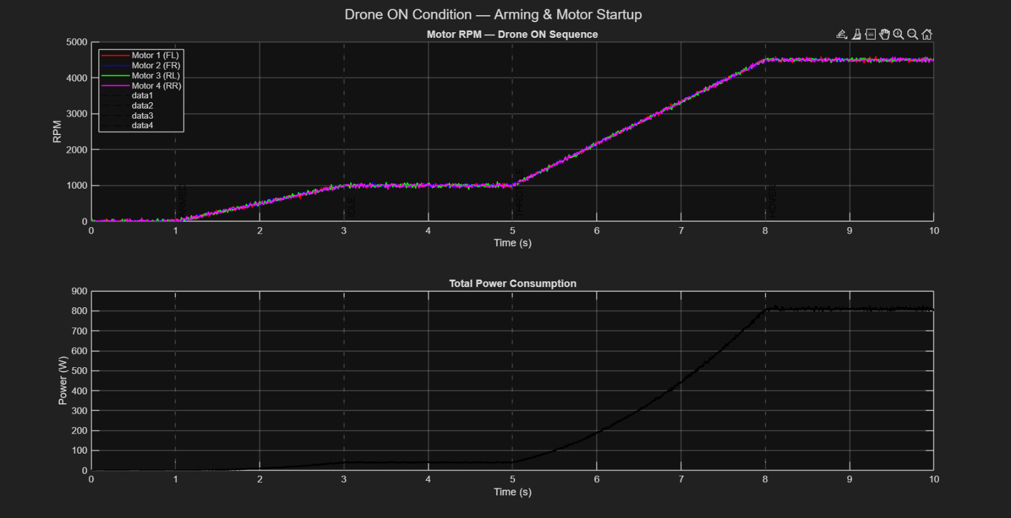

Slide 20
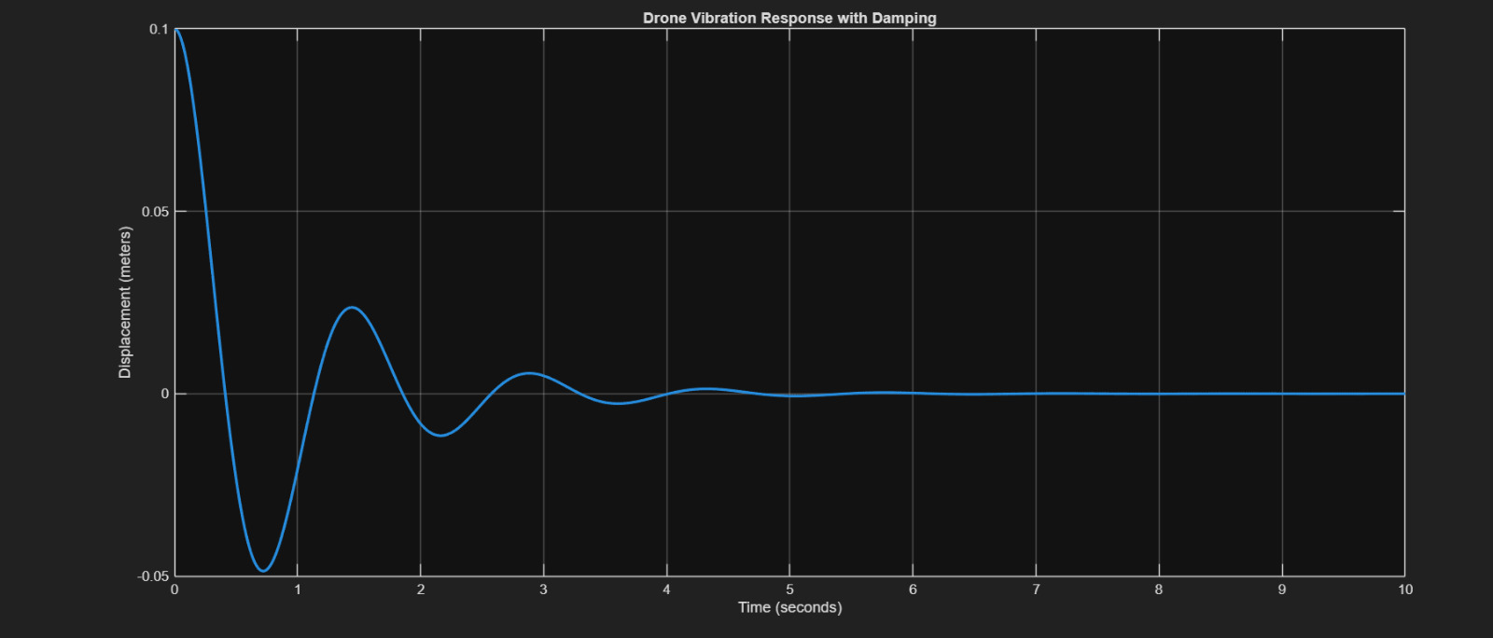

Slide 21
Simulation and evaluation of drone-related vibration control mechanisms involve modeling drone dynamics, analyzing, and reducing vibrations caused by propeller rotation and motor operation to improve flight stability, sensor accuracy, and image quality
. Key methodologies include using Finite Element Method (FEM) to analyze structural resonances and designing passive (e.g., rubber mounts) or active (e.g., sliding mode controllers) damping systems to minimize vibration transmission.
Key Findings in Simulation and Evaluation:
Vibration Sources: Propellers are identified as the primary source of drone vibration. In-flight vibrations are typically higher in the horizontal plane than in the vertical plane.
Impact on Performance: Uncontrolled vibrations can negatively affect the accuracy of onboard sensors (accelerometers/gyroscopes) and degrade communication system performance, especially at 5.8 GHz and 2.4 GHz frequencies.

Slide 22
Vibration Reduction Techniques:
Passive Damping: A designed rubber-based passive isolation system was shown to reduce resonance frequency by 33%, acceleration resonance amplitude by 60%, and lift amplitude by 50%.
Negative Stiffness: Incorporating Negative Stiffness Structure (NPS) can reduce motor/propeller vibration by up to 85.74% horizontally and 89.18% vertically during hovering.
Active Control: A robust sliding mode controller (SMC) applied to a camera mount can manage uncertainties and hysteresis in actuators.
Simulation Tools: MATLAB/Simulink is widely used for modeling dynamics, while ANSYS is commonly used for structural vibration analysis.
Validation Methods: Experimental tests, such as shaking table tests, are used to validate the results from Finite Element Analysis (FEA).
Common Evaluation Metrics:
Symbol Error Rate (SER): Used to evaluate communication system performance under vibration.
Root Mean Square G-value (Grms): Used to measure overall vibration intensity.
Power Spectral Density (PSD): Used to analyze the frequency distribution of vibrations.
Acceleration Amplitude: Used to measure the reduction in vibration intensity.

Slide 23
clc;
clear;
close all;
% System parameters
m = 1; % Mass (kg)
c = 2; % Damping coefficient
k = 20; % Spring stiffness
% Time
t = 0:0.01:10;
% Initial conditions
x0 = 0.1; % Initial displacement
v0 = 0; % Initial velocity
% Differential equation
A = [0 1; -k/m -c/m];
B = [0; 1/m];
C = [1 0];
D = 0;

Slide 24
sys = ss(A,B,C,D);
% No external force
u = zeros(size(t));
% Simulation
[y,t,x] = lsim(sys,u,t,[x0 v0]);
% Plot
figure
plot(t,y,'LineWidth',2)
xlabel('Time (seconds)')
ylabel('Displacement (meters)')
title('Drone Vibration Response with Damping')
grid on MATLAB AI Overview
Simulation and evaluation of drone-related vibration control mechanisms involve modeling drone dynamics, analyzing, and reducing vibrations caused by propeller rotation and motor operation to improve flight stability, sensor accuracy, and image quality
. Key methodologies include using Finite Element Method (FEM) to analyze structural resonances and designing passive (e.g., rubber mounts) or active (e.g., sliding mode c

Slide 25
Conclusion
Vibration control mechanisms significantly reduce drone vibrations.
Spring‑damper systems provide better vibration suppression.
Proper damping improves drone stability, sensor accuracy, and performance.

